Slide 1
Evaluating the Impact of the Audio-Visual Assisted Therapeutic Ambience in Radiotherapy (AVATAR) System Versus Anesthesia for Motion Management in Pediatric Patients with Wilms' Tumor Undergoing Radiation Therapy
Indiana University Simon Comprehensive Cancer Center
Principal Investigator: Jordan Holmes, MD, MPH
Co-Investigators: Megan Sloan, Emerson Taylor, Emilee Wilson, Sarah Akinterinwa, and Megan Knight

Slide 2
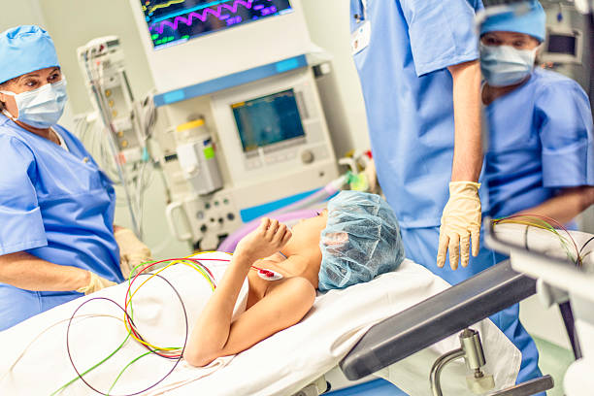
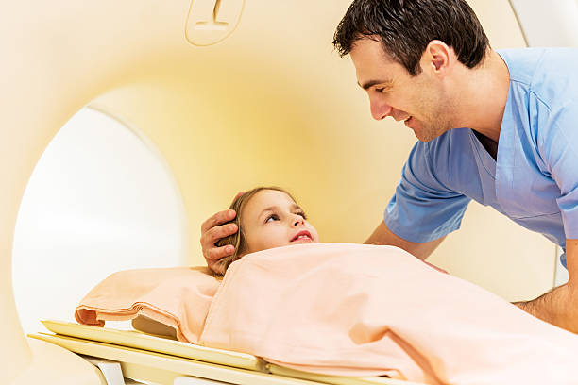
The Problem
Immobilization is critical in radiation therapy
Small movements compromise:
  treatment accuracy
  increase radiation exposure
  prolonged treatment time

Slide 3
Standard Approach & Drawbacks
Current standard approach: general anesthesia (GA)
Advantages of GA: reliable immobilization
Disadvantages of GA:
  Medial risks: upper-airway obstruction, hypoventilation, hypoxia, hypotension
  Post-anesthesia symptoms: nausea, disorientation, sleep disturbance, nightmares
  Increase resource utilization, time, and costs
What do we do about this? Hospitals are looking for alternative, non-pharmacologic method to minimize motion and to reduce or eliminate the need for anesthesia.

Slide 4
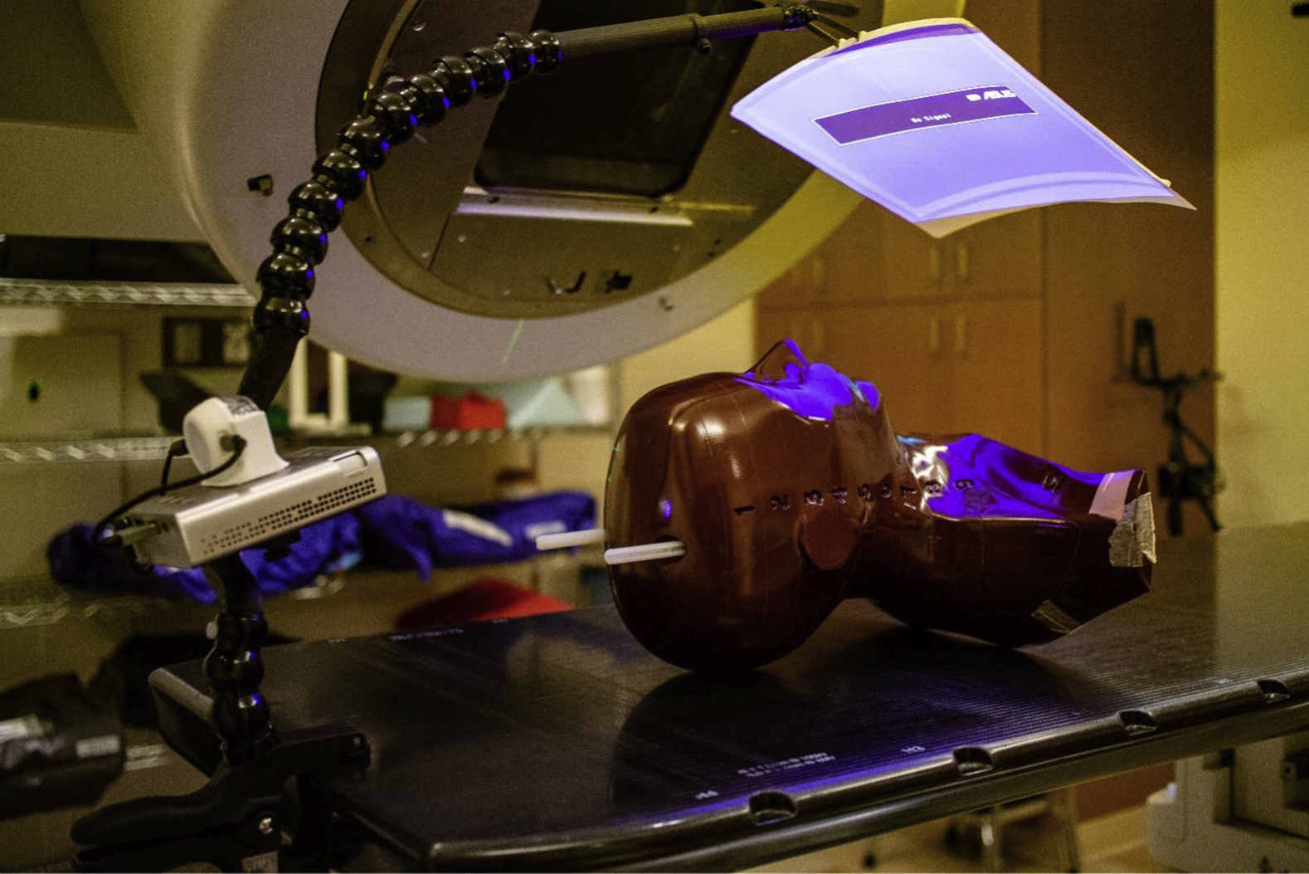
Introducing AVATAR
AVATAR: Audio-Visual Therapeutic Ambience in Radiotherapy
Patient focused audiovisual distraction
Video screen above patient during simulation and treatment
Radiation-compatible
Goal: to create a calm environment for the patient making the immobilization tolerable without the risks and burdens of daily anesthesia

Slide 5
Research Gap & Study Objective
Previous studies: AVATAR improves patient comfort and reduces anesthesia use; focused on cost/logistics rather than motion control itself.
Gap: There is limited comparative evidence of whether the AVATAR distraction can achieve the level of intrafraction immobilization that equates anesthesia in pediatric populations.
Primary Objective: To build on existing research, this study analyzed previously acquired data from pediatric patients with Wilms' tumors (nephroblastoma) to measure the intrafraction motion by comparing the use of anesthesia with the non-pharmacologic AVATAR distraction system.
Our findings have the potential to support the adoption of the AVATAR distraction system as motion management system

Slide 6
Review of Literature
Article #1 by Hiniker: Provided that AVATAR allows a majority of pediatric patients to undergo RT without sedation, the results being more precise and accurate treatment and less anxiety.
Article #2 by Ritchie: Provided that treatment relating to pediatric patients could be performed without GA to help ensure proper immobilization and fewer distractions. The study was not able to directly compare AVATAR to GA patient, or patients with Wilms tumors.
Article #3 by Prasad: Case report of 2-year-old patient being treated for therapy using AVATAR without the use of GA resulted in a decreased treatment time (2/3rds), a reduced risk of anxiety/anesthesia.
Article #4 by Balazy: Discovered that AVATAR was able to significantly decrease the rate of payer chargers, treatment times, patient compliance, etc.

Slide 7
Methods - Patient Selection & Study Design
Retrospective study between February 11, 2019 – July 31, 2025
Pediatric Wilms' tumor patients treated with EBRT at IUHSCC
Two groups: 20 patients went through treatment using AVATAR, while 12 patients had to go through treatment with the help general anesthesia
Inclusion: Patients were between ages 3-10 years old; had a confirmed diagnosis of Wilms' tumor; and were treated using AP or PA fields
Exclusion: Patients under the age of 3 and above the age of 10 years old; patients who received treatment for other cancers other than Wilm's; and a lack of paired kV/MV images

Slide 8
Methods – Imaging Analysis & Motion Measurements
Daily verification using orthogonal kV imaging
1st day MV imaging
Motion measured between kV (initial setup) and MV (final verification)
Measurement method: isocenter to vertebrae distance in horizontal and vertical axis
4 independent reviewers, averaged measurements
Timestamps from DICOM data
Two-sample t-test used for statistical comparison between the AVATAR and GA techniques

Slide 9
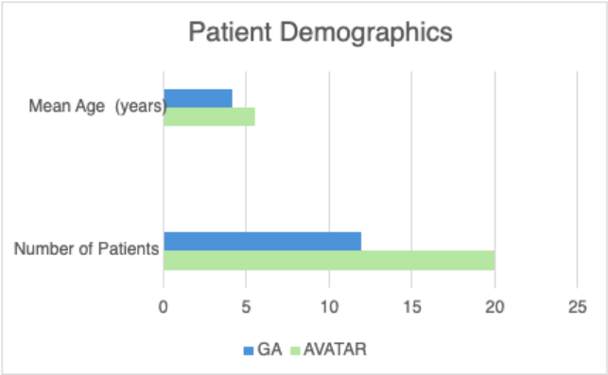
Results - Patient Cohort
32 pediatric patients (aged 3-10 yrs)
AVATAR: 20 pts, median age 5 yrs (range 3-9 yrs)
GA: 12 pts, median age 4 yrs (range 3-6 yrs)
Observation: older children are more likely to tolerate AVATAR; relationship between age and cooperation
Figure #1: Demographics showing the number of patients included as well as the median age, in years, of each group – AVATAR and GA.

Slide 10
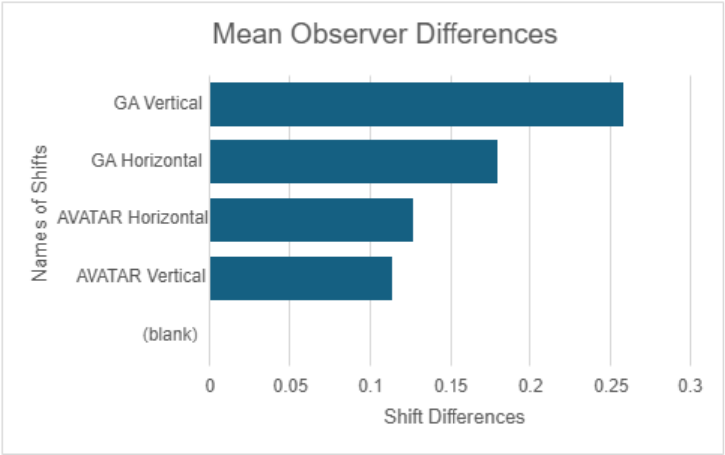
Results – Observer Consistency
4 observers cross-measured data
Average observer difference: 0.159 cm (all < 0.270 cm) → data collection reliable
Figure #3: Mean observer differences for horizontal and vertical motion (cm) across both groups

Slide 11
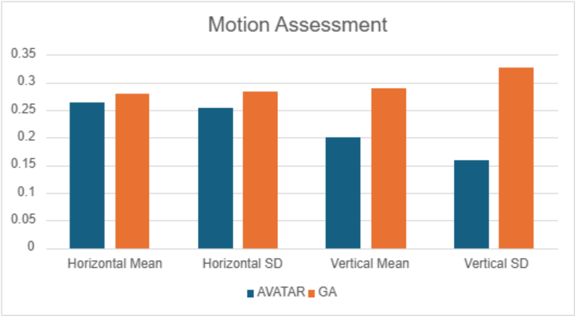
Results – Intrafraction Motion
Horizontal shift (mean ± SD): AVATAR 0.265 ± 0.255 cm
GA 0.280 ± 0.284 cm
Vertical shift (mean ± SD):
AVATAR 0.201 ± 0.159 cm
GA 0.290 ± 0.328 cm
Figure #2: Motion assessment showing mean and standard deviation of horizontal and vertical shifts (cm) for AVATAR and GA.

Slide 12
Results – Total Motion Assessment
Statistical comparison for horizontal shifts
p = 0.833 --> no significant difference
Statistical comparison for vertical shifts:
p= 0.232 --> no significant difference ​
Observation: Both AVATAR and GA provide effective immobilization.
Optional Reference:
T-test: compares the averages between 2 groups to see if the difference is meaningful
P value: probability the result is due to chance
p < 0.05: statistically significant, meaningful different
p >/= 0.05: not significant, groups are statistically similar

Slide 13
Results – Imaging & Treatment Times
AVATAR: 7 min 42 sec (range 1:41 – 21:26)
GA: 7 min 27 sec (range 1:55 – 15:16)
Observation #1: Times are nearly identical, with minor variations due to patient cooperation and setup.
Observation #2: AVATAR patients showed minimal to no motion during the typical beam-on period, demonstrating effective immobilization comparable to anesthesia
Observation #3: Although treatment length can vary, beam on time can be reflected by the time frames shown from kV to MV images

Slide 14
Discussion
AVATAR demonstrated effective motion management in pediatric patients
Improve patient cooperation and treatment experience
Supports the incorporation of AVATAR into standard pediatric RT workflow
Provides a non-invasive alternative to GA resulting in the reduction of anesthesia-related risks
Reduced imaging and shortening treatment times overall

Slide 15
Limitations
1.Small sample size limiting the generalizability of the research findings
2. Effectiveness of AVATAR is dependent on patient's age, anxiety, and stage of development
3. Use of AP/PA fields limit complexity of potential treatment techniques, which may lead to longer treatment times and restricts how the findings can be applied to more advanced setups or treatments
Motion could only be assessed through static imaging which does not fully represent
patient movement during more complex, longer duration treatments
4. Full setup times could not be measured, as study lacked technology needed to track start-to-finish setup duration which impacts the AVATAR overall efficiency or time saving remains uncertain

Slide 16
Conclusion
This study demonstrates that the AVATAR system is an effective and non-invasive method for motion management.
Key findings
  Comparable immobilization to general anesthesia
  Improved patient safety and comfort
  Efficient integration into workflow
  Potential for reduced healthcare burden
AVATAR represents a viable non-pharmacologic alternative to GA
These finding support broader adoption of AVATAR in pediatric oncology centers

Slide 17
Future Plans
Expand sample size to improve statistical generalizability
Conduct prospective studies with standardized AVATAR protocols across more pediatric treatment sites
Integrate real time motion monitoring
Compare workflow efficiency using full setup time measurements
Evaluate patient centered outcomes
Assess cost effectiveness and resource utilization of AVATAR vs anesthesia

Slide 18
References
Arlachov, Y., & Ganatra, R. H. (2012, November). Sedation/anaesthesia in Paediatric Radiology. The British journal of radiology. https://pmc.ncbi.nlm.nih.gov/articles/PMC3500799/
Balazy, K. E., Gutkin, P. M., Skinner, L., von Eyben, R., Fowler, T., Pinkham, D. W., Rodriguez, S., Maxim, P. G., Donaldson, S. S., Loo, B. W., Jr, Bush, K., & Hiniker, S. M. (2020). Impact of Audiovisual-Assisted Therapeutic Ambience in Radiation Therapy (AVATAR) on Anesthesia Use, Payer Charges, and Treatment Time in Pediatric Patients. Practical radiation oncology, 10(4), e272–e279. https://doi.org/10.1016/j.prro.2019.12.009
Hiniker, S. M., Roeske, J. C., Kang, H. C., Kozak, K. R., & Goldman, E. E. (2017). Initial clinical outcomes of audiovisual-assisted therapeutic distraction during pediatric radiation therapy. Practical Radiation Oncology, 7(4), e265–e272. https://doi.org/10.1016/j.prro.2017.01.006

Slide 19
References
Prasad, R. N., Baliga, S., Banner, J., Cadieux, C., Cetnar, A., Degnan, M., Depinet, M., Ewing, A., Hobbs, N., Jiang, A. L., Manring, I., Perlow, H. K., Rock, A., Skinner, L. B., Tenney, L., Walls, V., Hiniker, S. M., & Palmer, J. D. (2022). Radiation Therapy Without Anesthesia for a 2-Year-Old Child Using Audio-Visual Assisted Therapeutic Ambience in Radiation Therapy (AVATAR). Practical radiation oncology, 12(3), e216–e220. https://doi.org/10.1016/j.prro.2021.12.009
Ritchie, J. (2024). Paediatric radiation therapy without anaesthesia. Radiotherapy & Oncology, 196, 109084. https://doi.org/10.1016/j.radonc.2024.109084

Slide 20
Questions?

Slide 21
Thank you!
emertayl@iu.edu
sloanme@iu.edu
wilsoneg@iu.edu
sakinter@iu.edu

